Slide 1

Instagram User Analytics
By Rohit Paul

Slide 2
Overview
In the current scenario of multimedia platforms, Instagram is one of the most widely used social media platform.
With the help of user analytics, we can get insights on how users are interacting & engaging with Instagram which will help us to derive business insights for marketing, product & development teams.
These insights will help the team on making decisions for new features and organizing new events. It will also help to track the success of Instagram, measure user engagement and improve the experience altogether while helping the platform to grow.

Slide 3
Tech-stack used & Approach
In this project we are already provided with a data-dump of Instagram user data.
To create a Database from it I have used MYSQL, MYSQL Workbench 8.0 CE to solve the further queries and Excel is used to create the report.
The approach for this project is to get the marketing and investor Metrics related queries solved to provide a better insight which will help the management team.

Slide 4
Marketing Insights

Slide 5
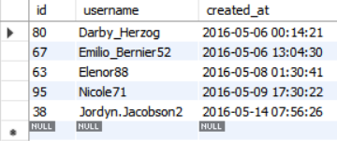
Rewarding Most Loyal Users
The old users tend to be one of the most loyal one. We can say that they are like the backbone of the platform.
We should show our gratitudes to these people for staying with instagram for such a long time and reward them for their continuous support towards instagram. This will encourage them to keep on using Instagram & there will be less chance of them switching over to other social media platforms.
Finding out 5 oldest/most loyal users on instagram:
SELECT *
FROM users
ORDER BY created_at ASC
LIMIT 5;
From the result we can find out 5 of the oldest users in ascending order along with the time when the account was created.

Slide 6
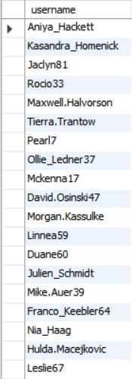
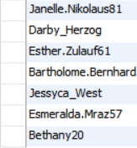
Reminding Inactive Users to Start Posting
We should notify our inactive users via promotional emails and encourage them to post their first photo.
There are some users who haven’t posted anything since the creation of the account. We should encourage them to post so that they can get familiar to the platform, share own thoughts etc.
Query to find out inactive users with no photos posted:
SELECT username
FROM users
LEFT JOIN photos
ON users.id = photos.user_id
WHERE photos.id IS NULL;

Slide 7

Declaring Contest Winner
Sometime to encourage users to keep posting different contests are organized.
These contests also helps management team to know more about different user preferences from what kind of posts they are sharing & what kind of posts they are liking. These helps to develop recommendation algorithm.
Identify the winner of the contest with most likes:
SELECT
username,
photos.id,
photos.image_url,
COUNT(*) AS total
FROM photos
INNER JOIN likes
ON likes.photo_id = photos.id
INNER JOIN users
ON photos.user_id = users.id
GROUP BY photos.id
ORDER BY total DESC
LIMIT 1;
We can see that, Zack_Kemmer93 is the winner of the contest with 48 total likes in his post.

Slide 8
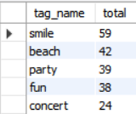
Hashtag Researching
Hashtags are words or keyword phrases which are used within a post on social media to help those who may be interested in the particular posts & will help to find similar kind of posts when the hashtag is used in the search section.
Popular/Trending hashtags helps different partner brands to choose the proper hashtags for their post which could reach out to people quickly through search or recommendation.
Identifying the top 5 most common hashtags:
SELECT tags.tag_name,
Count(*) AS total
FROM photo_tags
JOIN tags
ON photo_tags.tag_id = tags.id
GROUP BY tags.id
ORDER BY total DESC
LIMIT 5;
These 5 hashtags are suggested to the partner brands & these might help their post to reach out to most people on the platform.

Slide 9

Launching AD Campaign
Launching an ad campaign is one of the most effective way to share something in a massive scale.
Ad campaign helps in promoting the products to a much higher scale audience and helps in overall growth of an industry. So, knowing the day on which users are most active will help the campaign to be successful.
Most popular registration day:
SELECT
DAYNAME(created_at) AS day,
COUNT(*) AS total
FROM users
GROUP BY day
ORDER BY total DESC
LIMIT 3;
From the result, we can see that most of the users are registered on Thursdays and Sundays. So, the campaign is suggested to be scheduled on those two days.

Slide 10
Investor Metrics Insights

Slide 11

User Engagement
Investors are one of the reasons behind any project/platform to be successful. Sometime investors request the analytics of the project/platform to determine if they are investing in right place or not.
Instagram investors are requesting the analytics to ensure that Instagram is doing well and not becoming redundant like facebook.
Finding average user posts on instagram:
SELECT (SELECT Count(*)
FROM photos) / (SELECT Count(*)
FROM users) AS avg;
From the result we can see that Instagram has 2.57 photos posted per user.

Slide 12
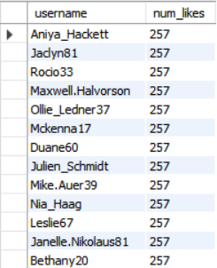
Bots & Fake Accounts
Instagram bots are services that allow to do tasks such as liking, commenting, and following, push ads without lifting a finger.
These bots create a fake analytics reports which really add hurdles to provide proper insights for Instagram. So, the Investors wants to know how many bots or fake accounts are there to know if Instagram is crowded or not.
Finding Bots/Fake accounts in Instagram:
SELECT username,
Count(*) AS num_likes
FROM users
INNER JOIN likes
ON users.id = likes.user_id
The way to find bots/fake accounts is to take a look on how many post they have liked. If any account has liked all the posts in Instagram it could be a bot.
GROUP BY likes.user_id
HAVING num_likes = (SELECT Count(*)
FROM photos);
From the result we can see that 13 accounts has liked all 257 posts in Instagram.

Slide 13
Conclusion
In conclusion we can say that analysing the data and providing insights helps in growth of multimedia platform such as Instagram in marketing and giving reports to investors.
From marketing perspective, with the help of different tools and analytics we can find out the specific informations which really help in decision making such as finding out loyal and old users and provide privileges, finding out inactive users and encouraging them to post.
Also, we can analyse and find out most popular hashtags and weekly days on which there are most number of users active so we can use them towards planning a post regarding any partner brand or organize ad campaigns to increase productivity.
From Investment perspective, we can help our investors by providing most needed data with graphs which will reassure them that they are investing into right platform. Analytics also helps investors to get insights on how the platform or company will do in further days.

Slide 14
THANK YOU

